Slide 1
NFL Big Data Bowl
Team 4: Tyler Crist, Dave Hogarth, Avery McNamee, and Nasiba Radjabova

Slide 2
Agenda
Competition Overview
Kaggle Example Evaluations
Example 1: Visualizing Correlations & Relationships
Example 2: Evaluation of Plays
Proposed Solution
Notes:
We are going to break this presentation into 3 easy components. First, we’ll give a brief overview of the competition itself,
Then we’ll talk about 2 examples within Kaggle that we found the most interesting. The first being the Visualizing Correlations and Relationships and the second one being the evaluation of plays.
Finally, we will discuss our proposed solution and what we found to be the most beneficial

Slide 3


Competition Overview
Develop a model to measure defensive performance on a passing play.
Provided
Game Film
Player-Level Data
NFL Next Gen Stats (i.e. position and speed)
Scoring
Submissions will be evaluated on the innovativeness, accuracy, relevance, clarity and Visualization
Focus on creating actionable insights
Timeline
Deadline to submit: January 7, 2021
Data collected for all possible passing plays during the 2018 regular season
Prizes
First: $15,000
Second: 15,000
Third: $15,000
Fourth: $15,000
Fifth: $15,000
Notes:
Looking at the competition overview, the goal of the competition was to develop a model that measured defensive performance on a passing play. The competition provided game film from all plays in the 2018 NFL season, player-level data and NFL Next Gen Stats, which in a nutshell just means they record every player’s position and current speed during a particular time.
The scoring was conducted on creativity, accuracy, relevance; meaning it can be used in a practical sense and not just for a competition, clarity and visualization
The timeline was the submit by Jan 7, 2021
$15,000 was given to each of the top 5 place holders and they also held a college-only division where the top 3 place holders each received $5k. The remaining $10k would be awarded after the winners from both the main and college division presented their submission to the NFL

Slide 4
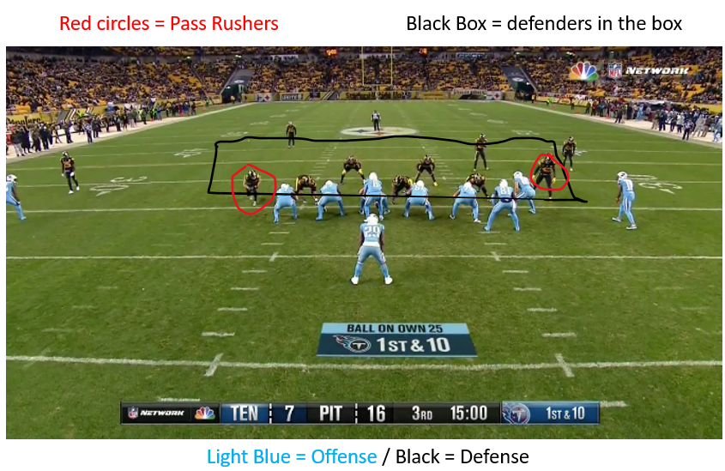
The Data
3 files: Games, Players, and Plays
40 total variables:
Date of game
Player height & weight
Player position
Offensive & Defensive formations
Pass Result
Number of Pass Rushers
Contains information for all “passing plays” during the 2018 regular season
Notes:
Looking more in depth into the data, the contestants were given three separate csv files; Games, Players and Plays from the 2018 season
There were a total of 40 different variables
Some are included above such as Offensive and Defensive formations, defenders in the box, number of pass rushers, etc
In the top right of the screen a skyview of an NFL game before the play starts, the black box indicates the number of players in black as defenders in the box, the players circled in red would be considered pass rushers, and for clarity, the light blue team is on offense and the black team is on defense
Also, to mention, “passing plays” only considered where a pass was thrown, the QB was sacked or any 5 penalties being called (DPI, OPI, Defensive holding, illegal contact or roughing the passer) that resulted in positive or negative gain in the play

Slide 5
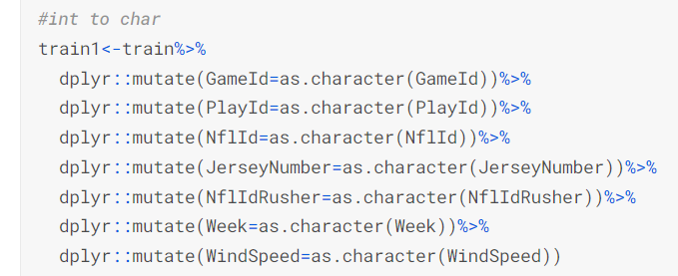
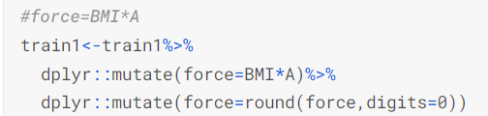
Example 1: Visualizing Relationships & Correlations
ML Tools Used:
Data evaluation (str, summary, and head functions)
Use of tidyverse and dplyr to mutate features as characters or integers
Created functions to rename stadiums and locations consistently
Variable creation: force associated with a player, rusher identification, whether the player is on offense or defense, whether the player’s team is in the lead, etc.
Ggplot library to visualize correlations
Notes:
https://www.kaggle.com/code/yutafm/nfl-ef

Slide 6
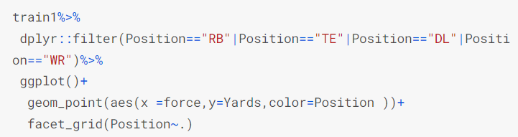
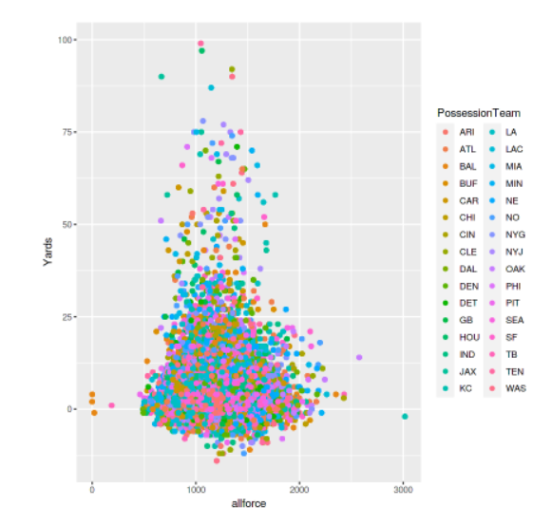
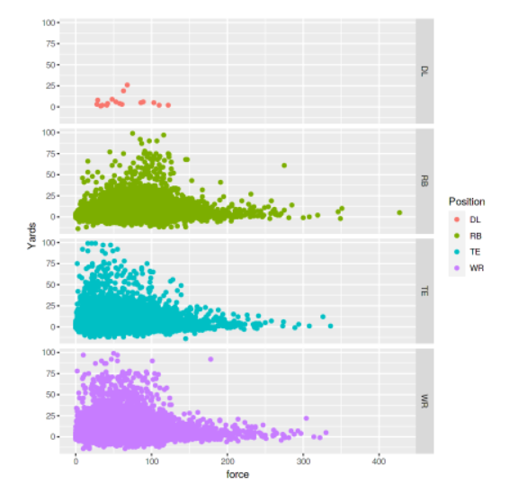

Slide 7
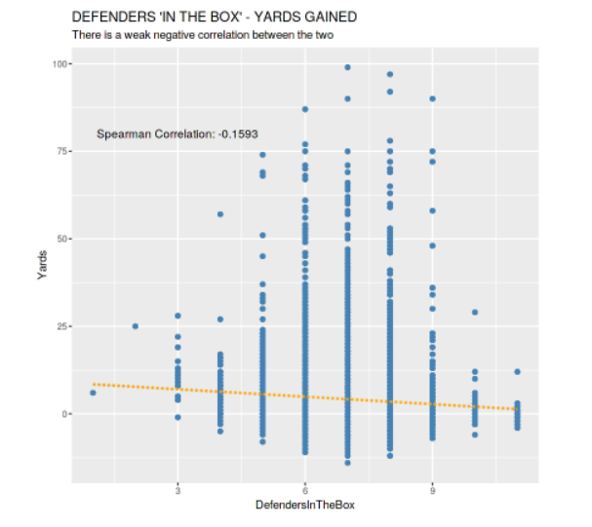
Conclusions from Example 1
A player’s force (A*BMI) has a correlation with yards gained
Yards gained is moderately influenced by team
Yards gained influenced by carrying player’s position
Weak negative correlation between defenders in the box and yards gained

Slide 8
Example 1: Evaluation
Strengths:
Skilled use of ggplot library to reveal existing correlations in the data
Creation of new variables added additional insights to the dataset
Ensured consistency within the data by using functions to standardize inputs
Weaknesses:
Deviated from problem intent by focusing on other relationships within the data (e.g. player weight & position)
Did not use forecasting methods to create predictions - simply evaluated which variables appeared to be the most influential in establishing yards gained
Limited usefulness

Slide 9
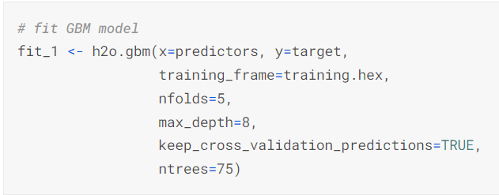
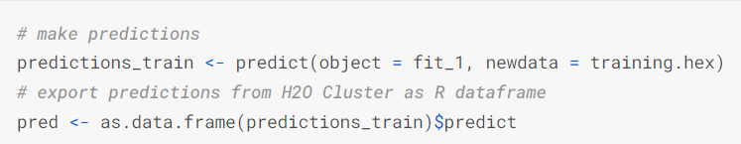
Example 2: Evaluation of Plays
ML Tools Used:
tidyr and dplyr – to convert between different data formats
h2o library for access to various machine learning techniques
gbm for the boosted regression model
predict to make/analyze predictions
ggplot2 to visualize data and correlations

Slide 10
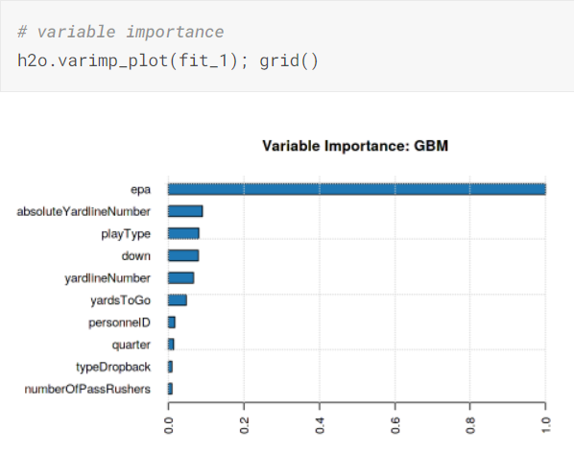
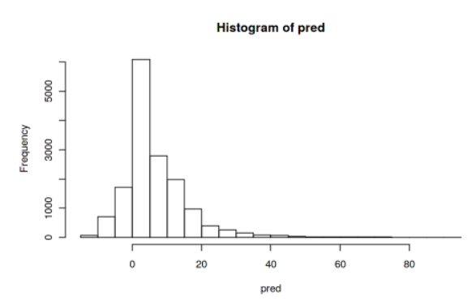

Slide 11
Example 2: Evaluation
Strengths:
Tested 5 folds of cross validation to determine the best
Addressed the strong correlation of variable EPA
Examined the partial dependence of other predictors
Very strong correlation (Pearson & Spearman)
Code allowed for consistency
Weaknesses:
Explored a variety of correlations and measures - easy to get lost in the code and makes distinguishing actionable insights challenging
Wordcloud felt out of place and distracted from the code
Notes:
Pearson correlation: Pearson correlation evaluates the linear relationship between two continuous variables.
Spearman correlation: Spearman correlation evaluates the monotonic relationship. The Spearman correlation coefficient is based on the ranked values for each variable rather than the raw data.

Slide 12
Our Code
Problem Statement: Focus on creating a model with significant predictive power that is consistent, clear, and easily understandable to relevant viewers to best create actionable insights.
Methods: Using multiple linear regression to predict Offense Play Result.
Final Predictors:
Yardline Number
Yards to Go
Pass Result (I, C, S, IN)
epa
Offensive Formation
Final Metrics:
Adjusted R-squared: ~.65
Test MSE: 37.9
Test RMSE: 6.2
Notes:
OffensivePlayResult = yards gained by the offense (this is how we chose to measure defense performance)
Yardline Number: Yard line at line-of-scrimmage
Yards to Go: Distance needed for a first down
Pass Result: Outcome of the passing play (factor with 4 levels: C: Complete pass, I: Incomplete pass, S: Quarterback sack, IN: Intercepted pass)
Epa = Expected points added on the play, relative to the offensive team. Expected points is a metric that estimates the average of every next scoring outcome given the play's down, distance, yardline, and time remaining (numeric)
Offensive Formation: Formation used by possession team (6 types = I Form, Jumbo, Pistol, Shotgun, Singleback, and Wildcat)

Slide 13
Evaluation of Our Code
Benefits
Predictive potential
Intuitive, direct, and parsimonious
Tests assumptions
Produces actionable insights
Significance of offensive and defensive formations and current yard position indicate the importance of well-developed team strategy for high performance during critical plays
Defensive implications
Interesting Findings
Player-specific statistics not as significant in predicting yardage (e.g. height and weight)
Notes:
***bringing it back to defensive implications, as that is the purpose of the competition
“The goal of submissions is to identify unique and impactful approaches to measure defensive performance on these plays.”

Slide 14
Questions?

